Slide 1

Extension of Time and Delay Analysis in Construction Disputes
What is realistic and achievable when claiming an EOT for reasons of social distancing, people self-isolating, or material shortages?
27 September 2022
Dermot McEvoy
Partner, Dispute Resolution & Litigation
The Gibson Hotel, White Paper Conference

Slide 2

Agenda
A general introduction to Construction Contracts and Extensions of Time (“EoT”)
Keating notes: “The phrase “construction contract” is used to include any contract where one person agrees for valuable consideration to carry out construction works, which may include building or engineering works, for another.”
Range of contractual relationships.
The construction programme and EoTs due to delay – requirements for notices, and entitlement to time and/or €s.
Relevant events frequently cited for delay claims.
Apportionment of blame and disputes – claims, Liquidated damages (LaDs”) &/or EoTs - v Time at Large arguments

Slide 3

Contractor caused delays 1
Frequently EoT clauses are intended to benefit the employer and to enable the employer to recover LaDs – which have been agreed as a genuine pre-estimate of loss.
Where contractors are seeking to rely upon an entitlement to an EoT it must look to the express provisions of the contract – standard form contracts frequently limit entitlement to time with no money.

Slide 4
Contractor caused delays 2
Keating suggests that EoT clauses are generally construed against the party relying upon any ambiguity in the contract, so contractors need to be wary. Delay events frequently are employer delay or neutral 3rd party delay events. So be wary as a contractor to consider the risks accepted on signing the contract for shortages of materials and/or Covid/Ukraine type events.
For the contractor to succeed it must establish that the delay complained of negatively impacted the progress of the works due to external employer controlled factors and this impacted the ability to meet the completion date.

Slide 5

Entitlements to time do not equate to an entitlement to €s
Employers start from the position that where a delay is occasioned by a contractor, and it was not mitigated and/or prevented that the employer is entitled to LaDs. Claims may extend to general damages too, but this is more problematic to succeed upon.
The UK courts have recognized the “Prevention Principle” such that employers cannot rely upon their own wrongdoing and benefit from breach. This is more a shield than a sword for the contractor and is used to defend claims for LaDs rather than to advance EoTs and entitlements to contractor damages.

Slide 6

Assessing EoTs claims / Critical path milestones
Various methodologies deployed by delay claim experts
  (a) impacted as-planned;
  (b) time impact analysis;
  (c) time slice window analysis;
  (d) as-planned vs as-built window analysis;
  (e) retrospective longest path analysis; and
  (f) collapsed as-built analysis.
Critical path analysis. The SCL Delay and Disruption Protocol defines critical path as “the sequence of activities through a project network from start to finish, the sum of whose durations determines the overall project duration.”
Sequencing of activities; issues will arise as to what is or is not on the critical path impacting the ability to complete on time.

Slide 7

Covid/other developments and the standard form contracts
Covid & Ukraine – supply chain disruption
Legislative changes –v- force majeure events, the impacts were industry wide across the entire supply chain – issues arise as to where the “pain” would be most felt – disputes ??
Standard Contracts.
RIAI – clause 30 (time but not money) – changes often sought to limit potential for contractor entitlements beyond time – including
“If it becomes apparent that the Works will not be completed by the Date for Completion as set out in the Contract for reasons beyond the control of the Contractor, then the Contractor shall so notify the Architect who shall grant, in writing, such extension of the time for the Date for Completion as he may consider reasonable.”

Slide 8
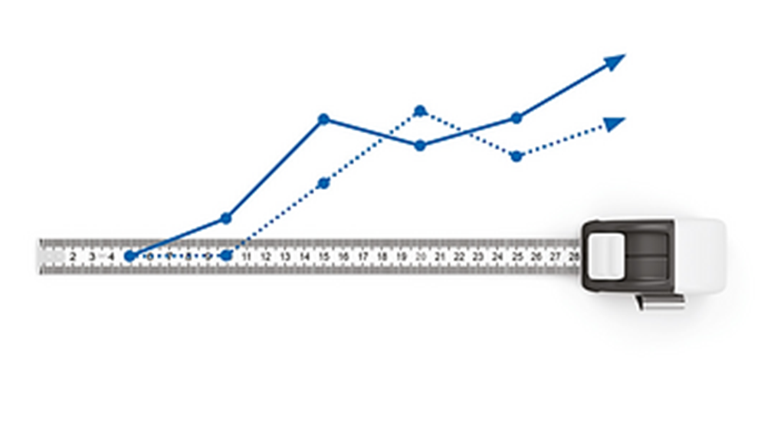
Covid/other developments and the standard form contracts
(RIAI ctd.) Potential for disputes due to delays, on site costs, social distancing measures, and other Covid compliance costs – wider supply chain disruption seen from Ukraine crisis and inflationary factors now prevailing. Contractors have safer recourse seeking to defend LaDs than advancing claims for money (and time) where there are no express provisions.
PWC contracts – gave contractors greater protection, not always followed in the private sector.
FIDIC Contracts – Red Book gave time & money; Silver Book EoT only and Yellow Book referenced a contractor’s entitlement to “reasonable profit” where it was entitled to an EoT.

Slide 9



Covid/other developments and the standard form contracts
NEC – again broader in its application and in countenancing an entitlement to time and money.
JCT – Generally permits time but no money.
All of these contracts excepting the RIAI incorporate very strict condition precedents.

Slide 10
The Prevention Principle
Multiplex Constructions (UK) Limited v Honeywell Control Systems Limited (No. 2)[[2007] BLR 195, Jackson J summarised the ambit and scope of the prevention principle in these terms:
Actions by the employer which are perfectly legitimate under a construction contract may still be characterised as prevention, if those actions cause the delay beyond the contractual completion date.
Acts of prevention by an employer do not set time at large, if the contract provides for an extension of time in respect of those events.
Insofar as the extension of time clause is ambiguous, it should be construed in favour of the contractor.
May have a negative impact on an ability to recover LaDs.

Slide 11
Notice Provisions
Courts and Arbitrators tend to take a stricter approach to compliance with condition precedents in assessing entitlement to claims for money (and potentially less so for time).
The courts themselves have also strictly interpreted any clause which appears to be a condition precedent. In Bremer Handelgeselschaft mbH v Vanden Avenne Izegem nv [1978] CSOH 190, the Scottish court determined that for a notice provision to be a condition precedent and binding that the following conditions had to be met:
(i) it should state the precise time within which the notice was to be served; and
(ii) it should state in plain and express language that unless that notice was served within the stipulated time, then the party making the claim would lose its rights under the clause.
Notice conditions can be waived, City Inns case.
The simple lesson is ensure that the records are strong if you want to advance or defend a claim.

